Slide 1
9:48:37 AM
LECTURE 5

Slide 2
GENERATING FUNCTIONS
Moments Generating Functions
Factorial Generating Functions
Probability Generating Functions

Slide 3





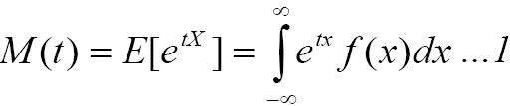
MOMENT GENERATING FUNCTION

Slide 4

MOMENT GENERATING FUNCTION

Slide 5





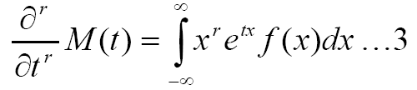

MOMENT GENERATING FUNCTION

Slide 6


MOMENT GENERATING FUNCTION

Slide 7
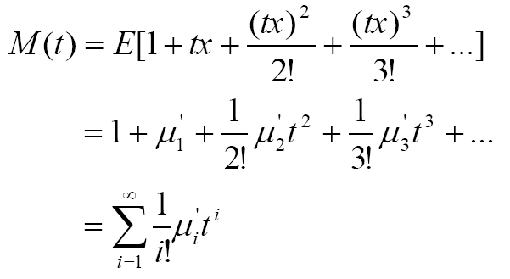



MOMENT GENERATING FUNCTION

Slide 8


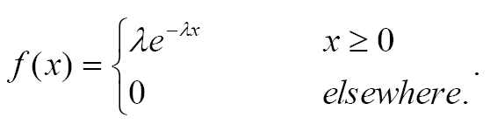

MOMENT GENERATING FUNCTION

Slide 9

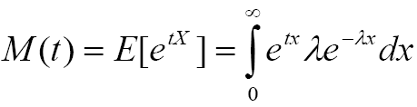
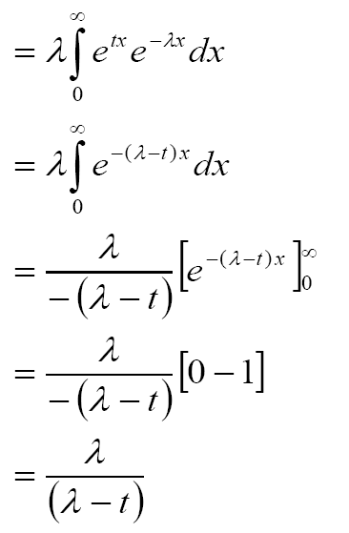
MOMENT GENERATING FUNCTION

Slide 10

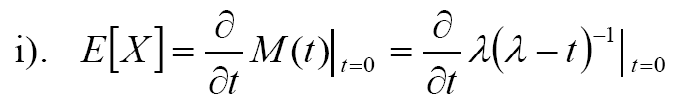
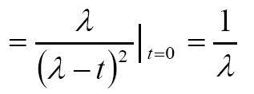
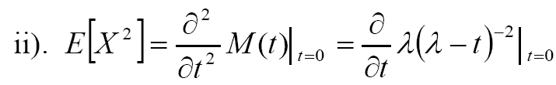
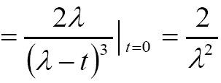
MOMENT GENERATING FUNCTION

Slide 11

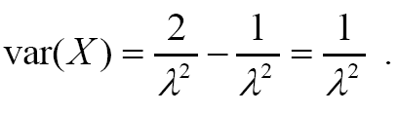
MOMENT GENERATING FUNCTION

Slide 12


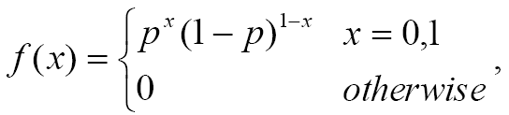

MOMENT GENERATING FUNCTION

Slide 13
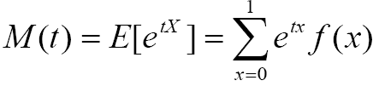
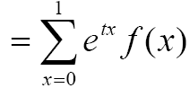
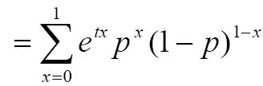



MOMENT GENERATING FUNCTION

Slide 14
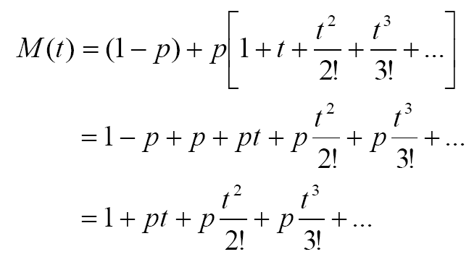
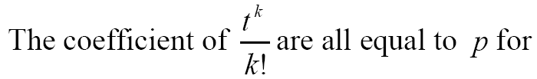

MOMENT GENERATING FUNCTION

Slide 15






MOMENT GENERATING FUNCTION

Slide 16

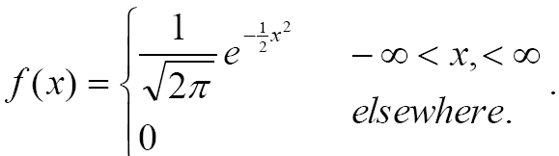

MOMENT GENERATING FUNCTION

Slide 17

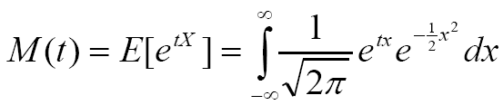
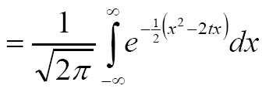
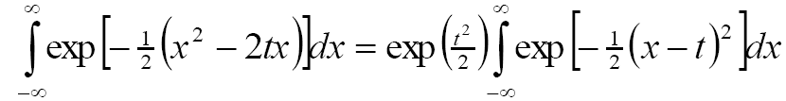
MOMENT GENERATING FUNCTION

Slide 18

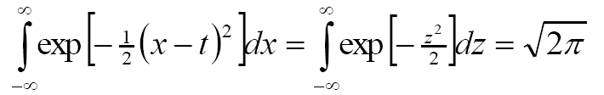

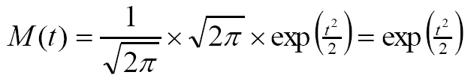
MOMENT GENERATING FUNCTION

Slide 19
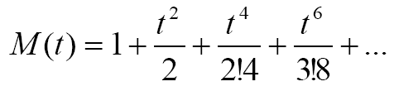
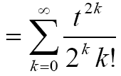



MOMENT GENERATING FUNCTION

Slide 20




MOMENT GENERATING FUNCTION

Slide 21

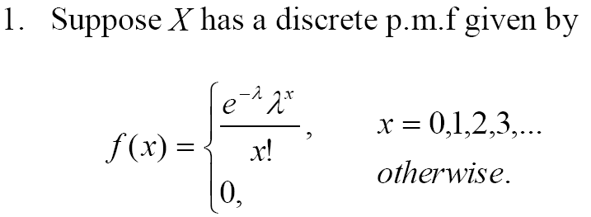

MOMENT GENERATING FUNCTION

Slide 22
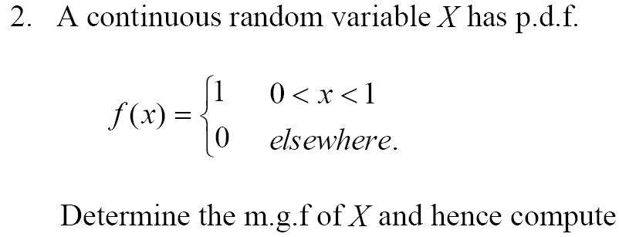
MOMENT GENERATING FUNCTION

Slide 23



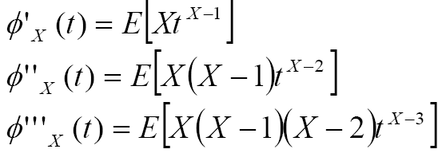
FACTORIAL GENERATING FUNCTIONS

Slide 24

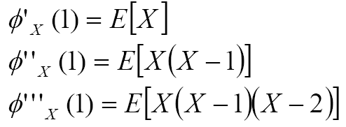
FACTORIAL GENERATING FUNCTIONS

Slide 25




FACTORIAL GENERATING FUNCTIONS

Slide 26

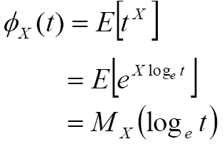
FACTORIAL GENERATING FUNCTIONS

Slide 27


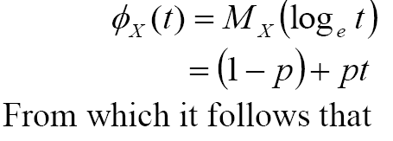
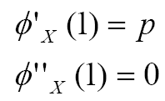
FACTORIAL GENERATING FUNCTIONS

Slide 28
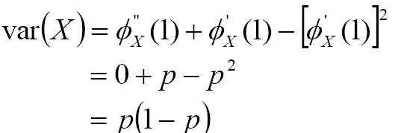

FACTORIAL GENERATING FUNCTIONS

Slide 29


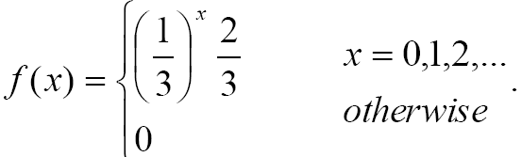



FACTORIAL GENERATING FUNCTIONS

Slide 30

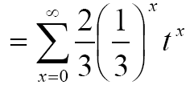

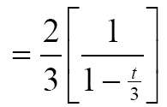
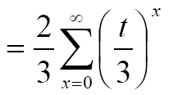

FACTORIAL GENERATING FUNCTIONS

Slide 31
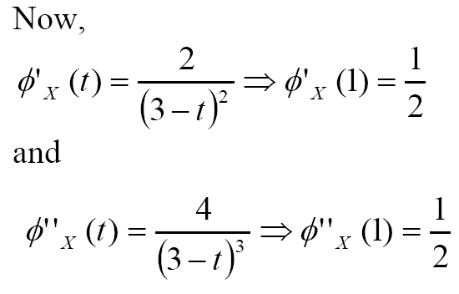
FACTORIAL GENERATING FUNCTIONS

Slide 32

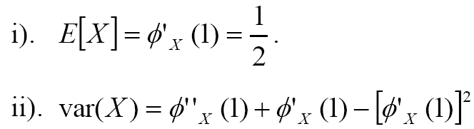

FACTORIAL GENERATING FUNCTIONS

Slide 33
9:48:39 AM
LECTURE 5

